Slide 1






Implementation and effectiveness of urban adherence clubs in Zambia
Monika Roy¹, Carolyn Bolton^{2,3}, Izukanji Sikazwe², Mpande Mukumbwa-Mwenechanya², Emilie Efronson² Paul Somwe², Estella Kalunkumya², Mwansa Lumpa², Anjali Sharma², Jake Pry^{2,4}, Nancy Padian⁵, Elvin Geng¹, Charles Holmes⁶
¹University of California San Francisco ²Centre for Infectious Diseases in Zambia ³University of Alabama ⁴University of California Davis ⁵University of California Berkeley ⁶Johns Hopkins University

Slide 2
Urban Adherence Clubs: Success Story?
The urban adherence club (UAC) model
  Provides off-hours facility access and group drug distribution
  Aims to improve on-time drug pickup and retention
Successes during scale-up in South Africa tempered by a recent report of high loss to follow-up and transfers back to facility-based care¹
Effectiveness evaluations limited to observational analyses which are subject to selection bias^{2,3}
Study Objective: We sought to evaluate the implementation and effectiveness of urban adherence clubs in Zambia using a randomized study design
¹ Nofemela A, Kalombo, C, Orrell, C, Myer, L. Discontinuation from community-based antiretroviral adherence clubs in Gugulethu, Cape Town, South Africa International Aids Society; 2016; Durban, South Africa.
² Luque-Fernandez, Plos-One, 2013 ³ Grimsrud, JAIDS, 2016

Slide 3
Community ART Study Design
Urban clinics in three provinces matched in pairs based on province, clinic size, and baseline retention
Five pairs selected: randomized to receive intervention or control
At both intervention and control facilities:
  Eligibility assessed
  Systematic sample of eligible patients offered UAC participation
At intervention clinics: received immediate UAC intervention
At control clinics: standard of care
Inclusion criteria:
  HIV-positive adolescents and adults (> 14 years of age)
  Last CD4 count (obtained within the last six months) > 200
  Not acutely ill
  On ART for at least 6 months
Exclusion criteria:
  Inability to participate in the group activities due to cognition deficits or mental illness.
  Pregnancy
Implemented at the clinic level. Analyzed at the individual level.

Slide 4
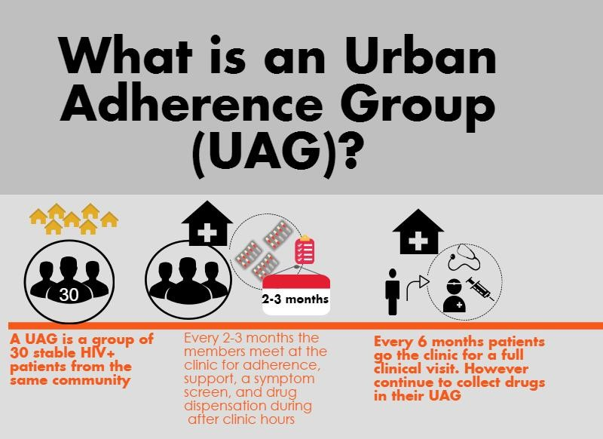
Urban Adherence Club Intervention
What is an Urban Adherence Club (UAC)?

Slide 5
Measurements
Analysis
Electronic medical record (Smartcare)
  Sociodemographic, laboratory, clinical visit, and pharmacy data
UAC group meeting attendance register
  Meeting attendance, drug pick-up, and symptom screen
UAC departure log
  Documented transfers and deaths
Qualitative interviews and focus groups with health care workers and participants
Active outcome ascertainment at end of study period
Primary outcome
  Patient retention in care defined as: Cumulative incidence of first missed drug pick-up > 7 days late at 12 months
    Kaplan-meier survival curves and log-rank
    Mixed effects logistic regression model with clinic and group as random effects
Secondary outcomes
  Alternative metrics of retention (14 or 28 days late, medication possession ratio (MPR)
  Implementation outcomes: acceptability, adoption, feasibility, fidelity
    Descriptive statistics
    Qualitative data analysis

Slide 6
Patient characteristics (N=1096)

Slide 7
Cumulative incidence of first late drug pick-up at 12 months
Control: 0.58 (95% CI: 0.53 - 0.62)
Control: 0.41 (95% CI: 0.37 – 0.45)
Intervention: 0.29 (95% CI: 0.25 - 0.32)
Intervention: 0.21 (95% CI: 0.18 - 0.25)
7 Days Late
28 Days Late
Log-rank test: p < 0.0001
Log-rank test: p < 0.0001

Slide 8
Predictors of first late drug pick-up (7 days late) at 12 months
Predictor | Unadjusted Odds Ratio | 95% CI | Adjusted Odds Ratio | 95% CI
Control (Standard of Care) | 3.41 | 2.64 – 4.39 | 4.22 | 1.61 – 11.1
Male Sex | 1.34 | 1.04 – 1.72 | 1.60 | 1.17 – 2.19
Age at enrollment | 0.98 | 0.97 – 0.996 | 0.99 | 0.97 – 1.01
Time since ART Initiation | 0.97 | 0.93 – 1.01 | 0.96 | 0.91 – 1.02
WHO Stage III or IV or CD4 < 200 cells/mm³ at HIV care enrollment | 0.86 | 0.65 – 1.14 | 1.10 | 0.76 – 1.59
MPR at study enrollment | 0.99 | 0.98 – 0.991 | 0.99 | 0.98 – 1.003

Slide 9
Patient adoption of Urban Adherence Clubs
597
594
594
592

Slide 10
Number of missed UAC visits per participant
40% of participants attended all visits
33% of participants missed 2 or more UAC visits

Slide 11
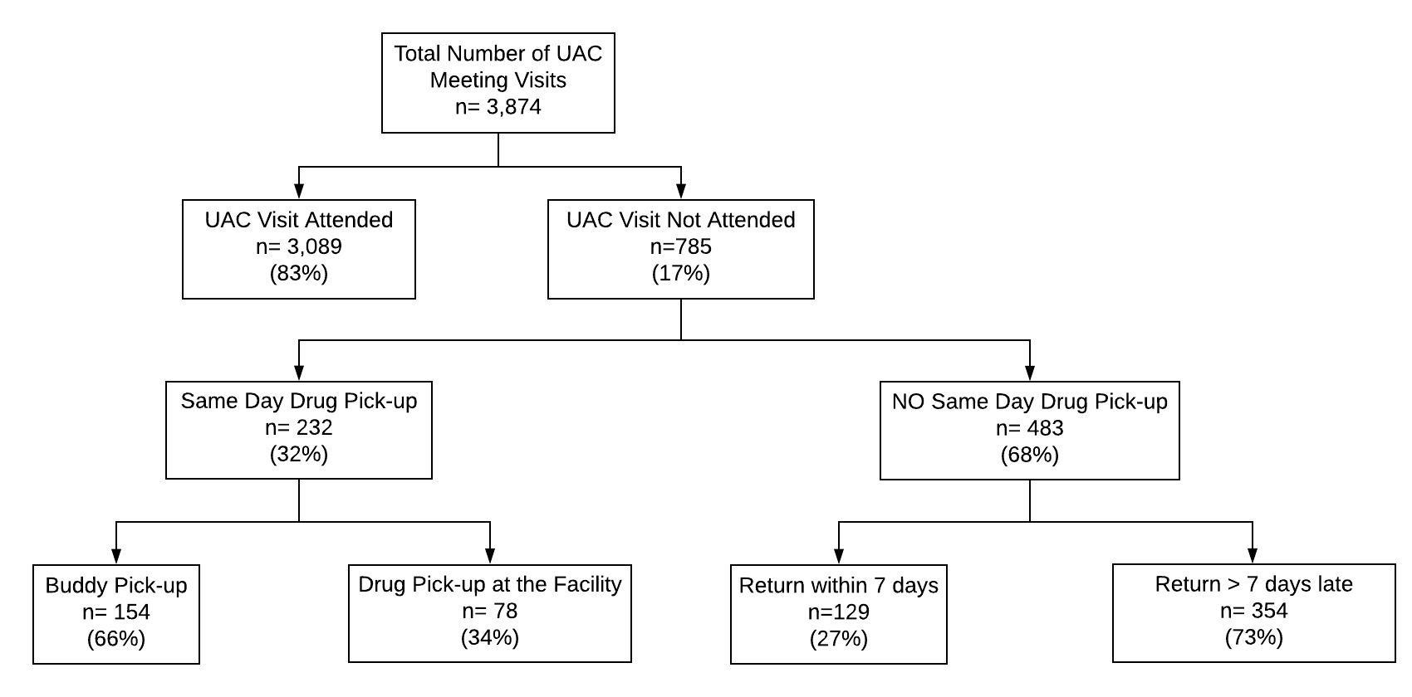
UAC Meeting Attendance
Of the 785 unattended visits, drug-pick up within 7 days still occurred in 361 (46%) of visits

Slide 12
Time to return after missed same-day drug pick-up (N=483 visits)
Cumulative incidence of return after missed drug pick-up:
  25% at 7 days
  36% at 14 days
  45% at 28 days

Slide 13
Reasons and timing of UAC departure
Reason for UAC departure | n (%)
Pregnancy | 10 (23%)
Transfer to another clinic | 9 (21%)
Loss to follow-up from care | 6 (14%)
Patient preference for facility-based care | 4 (9%)
Patient not following UAC code of conduct | 4 (9%)
Diagnosed with tuberculosis | 4 (9%)
Other | 3 (7%)
Death | 3 (7%)
Total | 43 (100%)
Time to departure after enrollment

Slide 14
Acceptability, Adoption, and Feasibility: findings from qualitative research
Health care worker perspectives
  Concerns about requirement of pharmacy technologists to work off-hours and spend additional time pre-packaging medication
  UAGs considered acceptable (clinic decongestion) and feasible, but contingent upon investments in human resources, infrastructure
Patient perspectives
  Timing of drug collection particularly suited patients who worked
  Group size and mixed gender composition acceptable
  ART delivery through groups enabled information sharing and peer support
  Inadvertent disclosure was not reported and stigma concerns reduced as patients were not seen at the clinic during regular hours
“At least now I am able to talk with my friends in the UAG. I am able to know people now. In fact, I am free. I feel like now the UAG is my family.”

Slide 15
Study Limitations
Study design:
  Limitations in power due to number of clusters (clinics and groups)
  Duration of follow-up relatively short, limited ability to comment on sustainability and long term outcomes
Measurements:
  Incomplete data in electronic medical record
  Viral load testing in progress, not yet reported

Slide 16
Conclusions
Twelve-month cumulative incidence of first missed drug pick-up significantly lower among intervention participants at 7 and 28 days compared to control participants
UACs were acceptable and feasible and initial patient adoption was high
Most patients missed at least one visit, but recovery (drug pick-up within 7 days of missed visit) occurred in almost half of all unattended UAC visits
Migration out of UACs occurred and were due to changes in clinical status (pregnancy, TB, etc) as well as patient preference

Slide 17
Implications
UACs are an effective tool in the DSD toolbox for reducing late drug pickup
The choice of group-based multi-month refills amongst other effective DSD options will depend on the context and clinic population
  Better for clinics with limited space, more challenging for human resources
The frequency of alternative same day drug-pick up argues for the need for DSD models to be flexible and patient-centered
Successful monitoring and evaluation will need to account for migration into and out of DSD models

Slide 18



Thank You
Questions?
We would like to thank the Zambian Ministry of Health, Ministry of Community Development and Social Welfare, and all participating patients and health workers.

